Slide 1
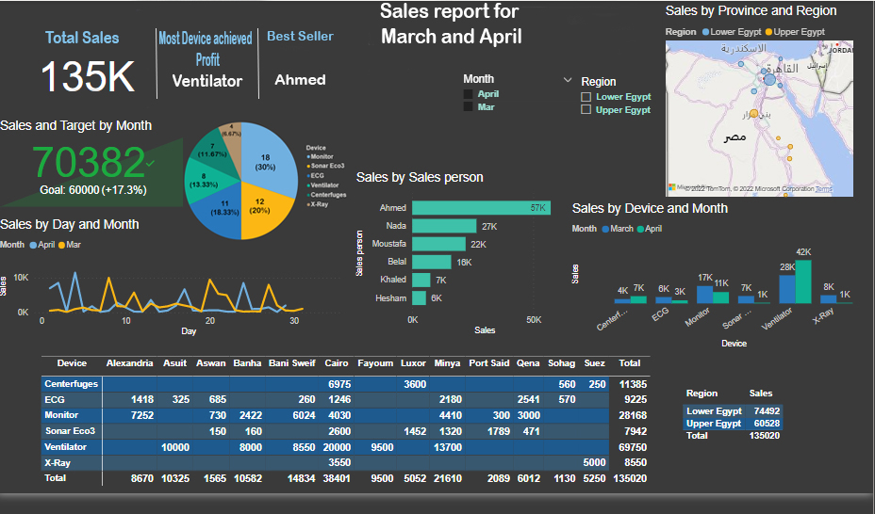
An overview on the sales report

Slide 2
In Details →

Slide 3


Plz note that, this is an interactive Dashboard, which means you can select Month to show the sales of that specific month, or to select a specific region to see the sales of this region and also you can filter whether by each device or each province

Slide 4
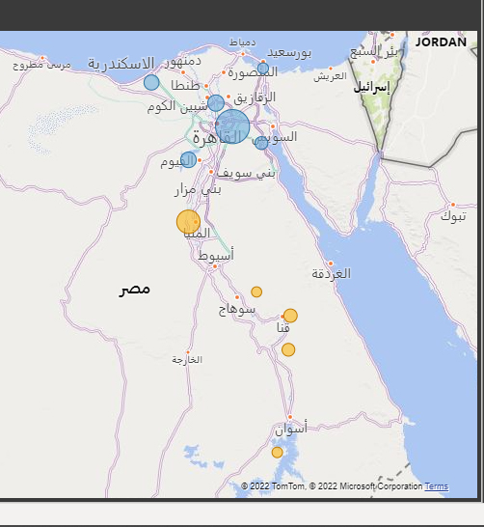
This is a visual map that shows in which area is the sales occurred, the bigger bubble indicates to the larger sales profit.
Yellow bubbles indicates to Upper Egypt and the blue ones indicates to Lower Egypt .

Slide 5
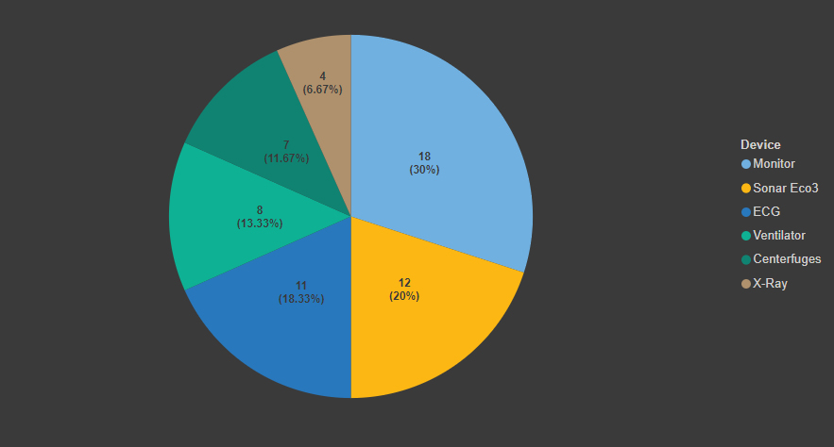
This pie chart counts the number of sales for each device and also calculate the percentage of total count.
And as we can see the monitor was sold the most with 18 times in the 2 months while X-Ray was the least with only 4 sales

Slide 6
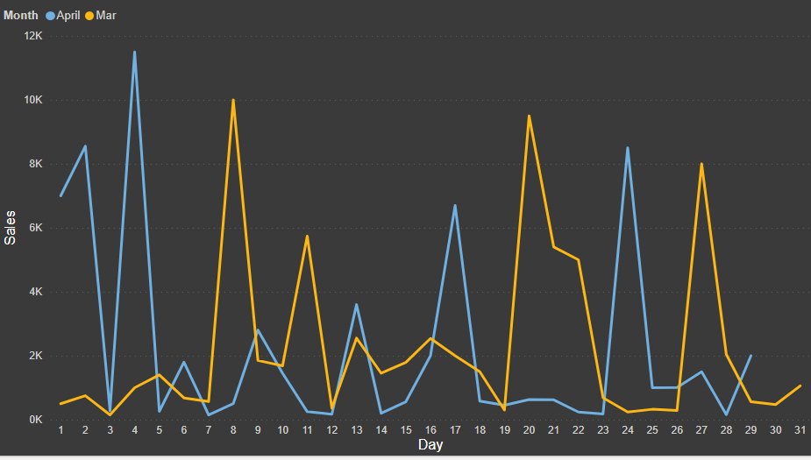
This Line Graph shows a sales comparison in April and March in 2022 , as we can see biggest sales occurred in March were on March 8 with almost 10k EGP, March 19 with almost 9k EGP and March 27 with 8k EGP.
While biggest Sales Occurred in April was on April 4 with more than 11k EGP

Slide 7
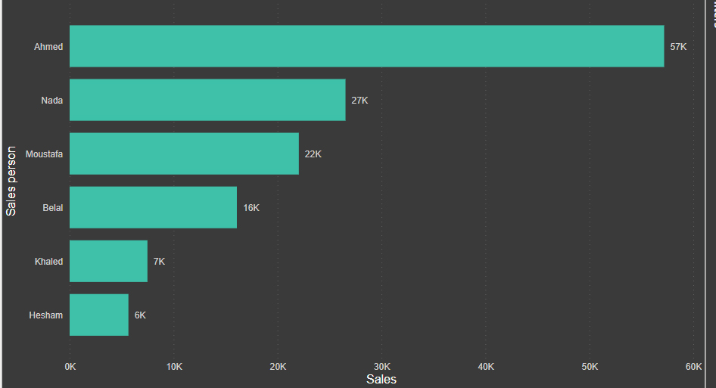
This Bar Chart shows which seller achieved the most sales for the company , as it shows here Ahmed had the most Sales with 57k EGP and Nada comes second with 27k EGP

Slide 8
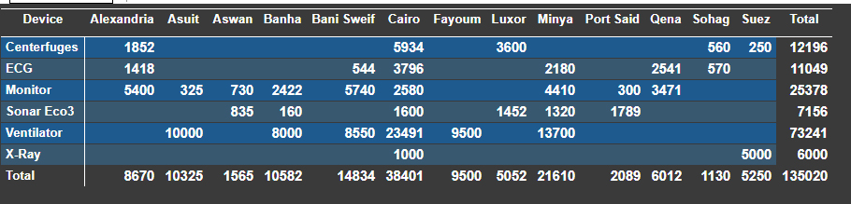

- The first table shows the total of Sales for each device and each Province, as we can see Cairo has the most sales with 38,401 EGP and the Ventilator has the most sales with 73,241 EGP
- And the second table shows the total sales for each Region

Slide 9
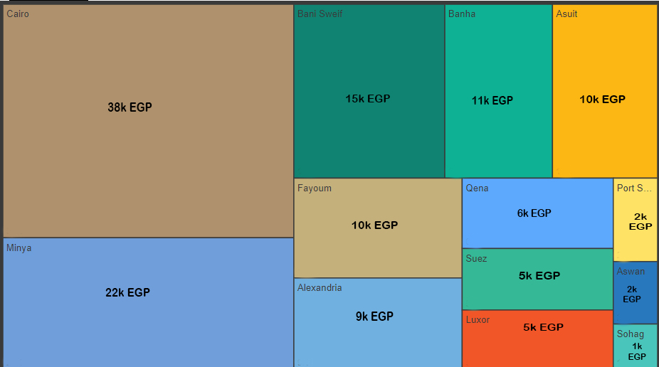
This heatmap shows the most Cities that has most sales in March and April, and as we can see Cairo has the most sales with 38k EGP and Sohag has the least Sales with only 1k EGP
Suggestion :
To find out the reason why the sales in Sohag is that low, we can switch the sales man who represents this City with a more talented sales man like “ Ahmed” in our case to see if the issue was about the sales man

Slide 10
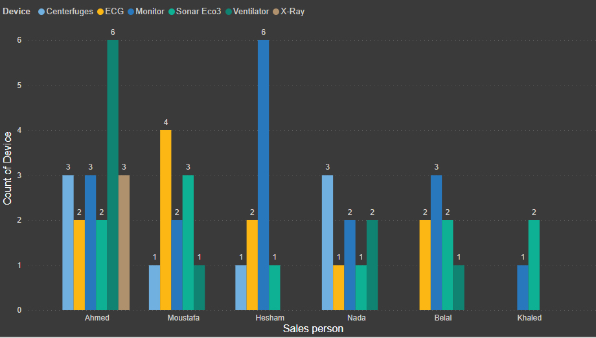
This clustered bar chart shows which device for each sales man was sold the most and how many times.
It shows that :
Ahmed was the most one who sold Ventilator by 6 times
Moustafa sold ECG 4 times, no one has sold ECG more than him
While Hesham has the most sales of the Monitor
Nada sold Centrifuges 3 times which is the most one with Ahmed
The most sales Belal has done was the Monitor , 3 times
And finally Khaled sold Sonar Eco3 2 times

Slide 11

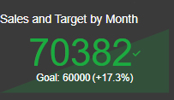
This is a quick brief of the analysis that shows The Total Sales in the 2 months “March and April ” for the 2 regions “ Upper and Lower Egypt”.
Also shows the most Device that made profit which is Ventilator.
And the best Seller for these 2 months was “ Ahmed “.
This shows the Target that the company set which was 60,000 EGP, but as we can see the sales exceeded the Target with more than 17 %

Slide 12
These type of analysis helps to make a better decision based on Data, like ..
Why this city has the least sales ?
Why this specific sales man has the least sales in this region, and how we can fix that ?
Why this specific device is not sold in this City? What are the suggestions to solve this issue?
And more …..
“By Analyzing this Data we answer questions of what, how and why”
“with more historical Data we will be able to forecast the sales for the next
year”

Slide 13


For Contact
: Yasser.ma.h199@gmail.com
: (+2) 01022298790
Eng / Yasser Mahmoud

